Slide 1


Malicious
URL Detector
Marco Fresco & Fabio Fadda
Artificial Intelligence for Cybersecurity
Master’s Degree in Cybersecurity
Academic Year 2023/24

Slide 2
Goal Definition
Drive-By Downloads
Real-Time Protection
Execute malicious code on the victim’s system
03
04
Identifying and blocking access to harmful URLs
Malware Distribution
02
05
Early Threat Detection
Host or redirect to sites that distribute malware
Preventing users from interacting with dangerous content
Phishing Attacks
01
06
Reducing Attack Surface
Lead users to fake websites that mimic legitimate ones
Prevent potential entry points for cyberattacks

Slide 3






Common Characteristics of Malicious URLs
Misspelled Domain Names
Unusual Characters
Cybercriminals register domains that are intentionally similar to well-known websites
Used to confuse users or evade detection
IP Addresses
Lack of HTTPS
Raw IP Addresses instead of domain names to bypass domain registration requirements
Phishing sites may not have valid SSL certificates (HTTPS)
Long, Random Strings
Overuse of Subdirectories
Attempt to obfuscate the true purpose of the URL
A technique to obscure the final destination

Slide 4


Data Gathering
PhishTank
Data and information about phishing on the Internet.
Kaggle
Platform for data science competitions

Slide 5




01 - Data Cleaning
Identifying and correcting errors, inconsistencies and inaccuracies
Data Pre-Processing
02 – Class Balancing
As imbalancing can lead to biased model and misleading accuracy
03 – Feature Extraction
Enhancing the model’s ability to learn patterns in the data
04 – Heuristics
Comparison with some of the empirical rules found in literature

Slide 6




Feature
Extraction
Length
Special Chars
HTTPS
IPv4 Address
Depth
CCTLD

Slide 7
Heuristics Confrontation
Special Chars
IPv4 Address
100% Malicious URLs
'@’ Symbol: 93.827%
‘-’ Symbol: 90.126%
‘_’ Symbol: 53.846%
Reference: Youness Mourtaji, Mohammed Bouhorma, Daniyal Alghazzawi, Ghadah Aldabbagh, Abdullah Alghamdi, "Hybrid Rule-Based Solution for Phishing URL Detection Using Convolutional Neural Network”.

Slide 8
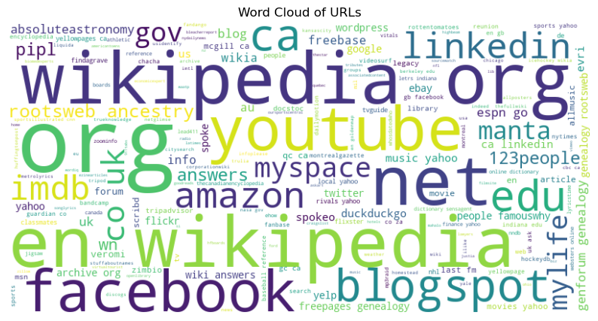
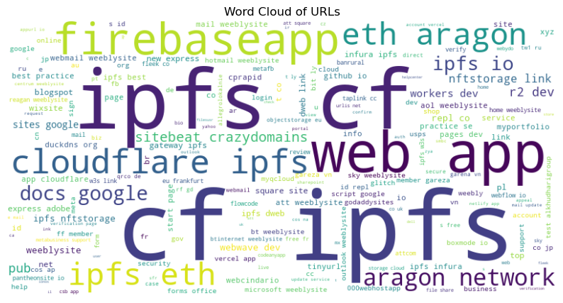
Preliminary Data Exploration
Benign
Malicious

Slide 9
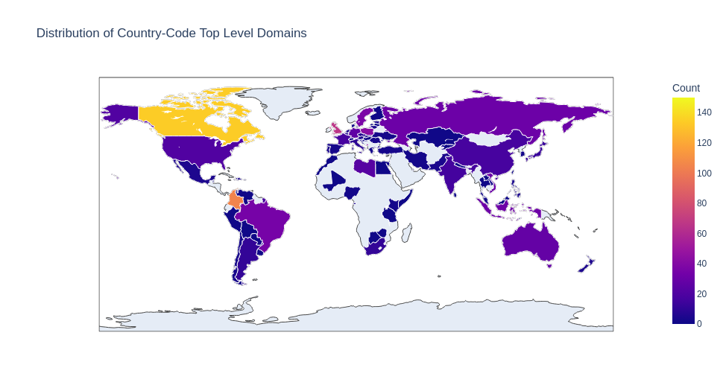
Preliminary Data Exploration

Slide 10
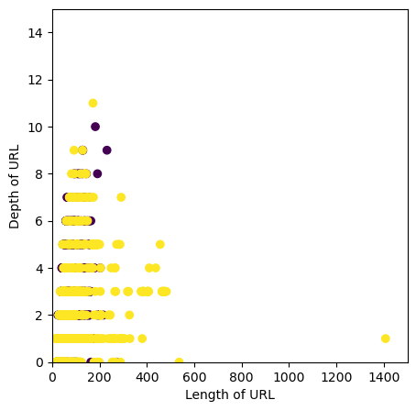
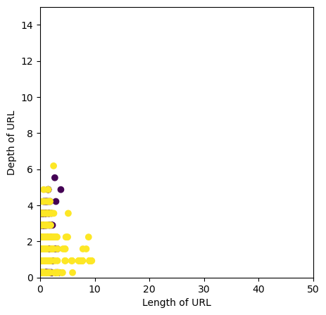
Normalization process
Z-Score

Slide 11

Data Mining
Random Forest Classifier
Gaussian Naive Bayes
Decision Tree Classifier
Logistic Regression
Linear SVC

Slide 12
Performance Evaluation
Precision
Recall
Accuracy
F1-Score

Slide 13
Holdout Method
Dataset
Training Set
Test Set

Slide 14
Stratified K-Fold
Fold 1
Testing set
Training set
Fold 2
Training set
Testing set
Training set
.
.
.
Fold k-1
Training set
Testing set
Training set
Fold k
Training set
Testing set

Slide 15
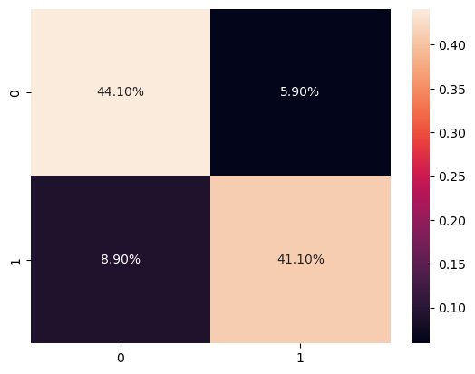
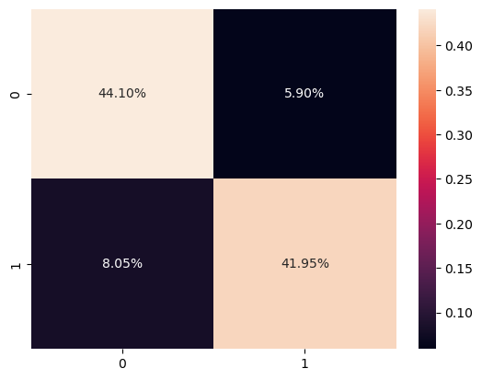
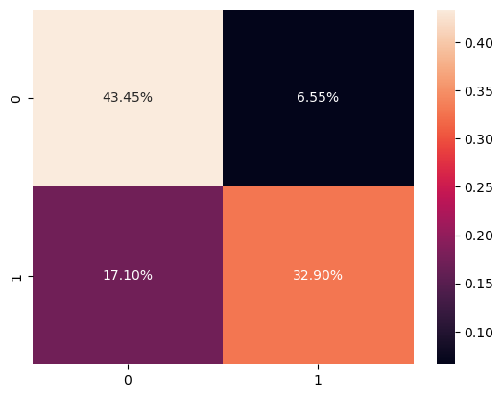
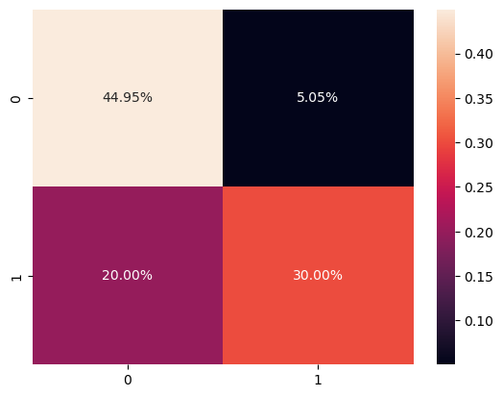
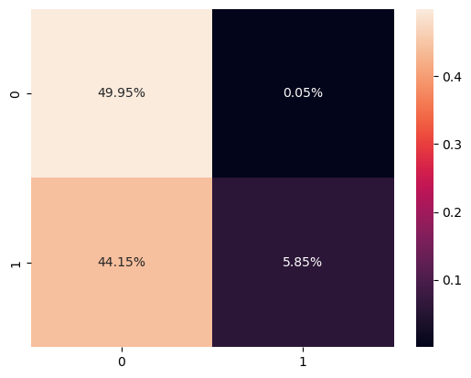
Results – Hold out
Decision Tree Classifier
Random Forest Classifier
Logistic Regression
85.20%
86.05%
78.35%
Linear SVC
Gaussian Naive Bayes
74.95%
55.80%

Slide 16
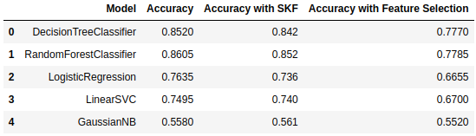
Results – Accuracy

Slide 17
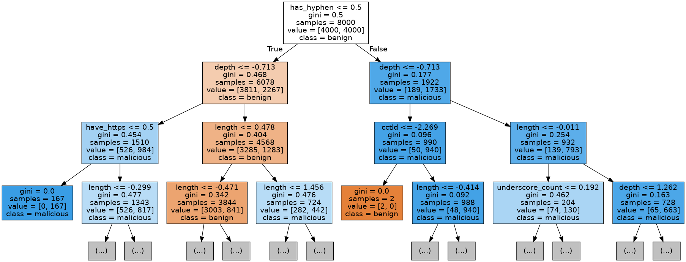
Decision Tree Representation

Slide 18
System Improvement
HTML encoding
JavaScript code
Request parallelization
Updated/Tested Dataset

Slide 19
Thanks For The Attention!

